Slide 1

Multicore Technology, Web 2.0 & Web 3.0
Exploring Hardware Parallelism, VM Scalability, Social Platforms, and the Semantic Web Convergence

Slide 2
Module 1: Multicore Technology & Cloud Parallelism
Hardware Foundations, Virtual Machine Scalability, and Distributed Compute Paradigms in Modern Cloud Infrastructure

Slide 3
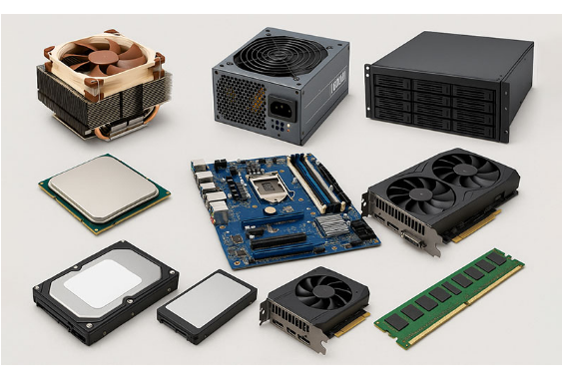
Multicore Processors in Cloud
Hardware Architecture Shift
As single-core frequency scaling hit thermal power limits ("frequency wall"), processor vendors transitioned to placing multiple execution cores on a single physical die.
•
Independent Cores: Each core executes program threads autonomously with L1/L2 caches.
•
Shared Infrastructure: Cores share L3 cache, high-speed interconnects, and memory controllers.
•
Symmetric Multiprocessing (SMP): Uniform access to system RAM across all cores for balanced OS execution.

Slide 4


Multiprocessors & VM Scalability
Hypervisor Core Allocation
NUMA & Memory Alignment
Modern Hypervisors (KVM, ESXi, Hyper-V) map virtual CPUs (vCPUs) directly to physical cores and hardware threads (Hyper-Threading).
Non-Uniform Memory Access (NUMA) arranges cores and memory into local nodes to maximize bandwidth and minimize cross-socket latency.
Multicore architectures allow virtual machines to scale vertically by dynamically assigning 32+ vCPUs to heavy workloads like database engines.
Cloud hypervisors leverage NUMA-aware scheduling to place VM compute and memory within the same socket node, avoiding cache line bouncing.

Slide 5






Parallelism Requirements in Cloud
Task Parallelism
Data Parallelism
High Throughput
Decomposing large computations into discrete independent subtasks executed simultaneously across multiple cloud CPU cores.
Partitioning massive datasets (e.g., MapReduce, Apache Spark) to execute identical operations on separate data chunks concurrently.
Simultaneously handling thousands of web requests, microservice API calls, and tenant isolation workloads without IO starvation.

Slide 6
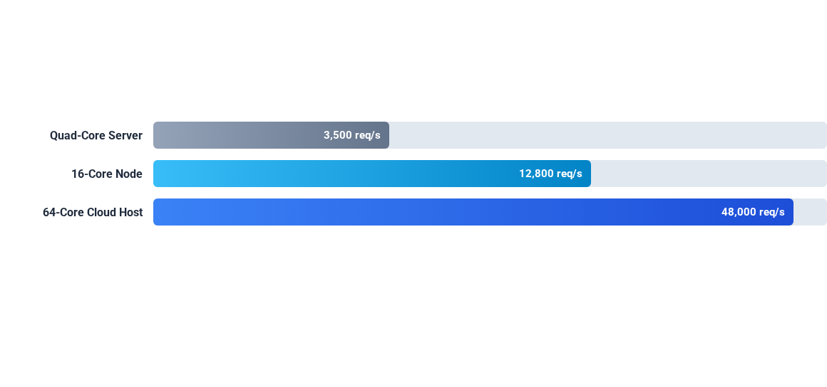
Multicore Efficiency in Cloud
Scaling CPU core density increases request throughput near-linearly while drastically reducing server footprint and energy consumption per virtual guest.

Slide 7
Multicore Enterprise Deployment
AWS Graviton3 & AMD EPYC: Modern cloud providers deploy 64-core to 128-core CPUs to power compute-optimized instances (e.g., c7g, c6a).
Container Orchestration (Kubernetes): Granular CPU pin allocation allows core-level isolation for microservices, preventing noisy-neighbor bottlenecks.
AI & Big Data Processing: Multicore host systems feed high-speed memory channels needed for parallel LLM inference and distributed SQL query execution.

Slide 8
Module 2: Evolution from Web 1.0 to Web 2.0
From Static Content Delivery to Dynamic Interactivity, Social Engagement, and Cloud-Powered Web Applications

Slide 9
Web 1.0 vs Web 2.0 Technical Shift
Architectural Dimension | Web 1.0 (Static Web) | Web 2.0 (Social / Dynamic Web)
User Role | Passive Consumer (Read-Only) | Active Creator / Participant (Read-Write)
Content Delivery | Static HTML pages hosted on servers | Dynamic AJAX/REST APIs with client rendering
Data Flow | One-directional (Publisher to Audience) | Bi-directional & Multi-directional Interaction
Core Platform | Personal Websites & Directories | Social Media, Wikis, Cloud SaaS Apps

Slide 10

Key Characteristics of Web 2.0
User-Generated Content
Users actively publish blogs, videos, posts, and reviews (e.g., YouTube, Wikipedia, Medium).
Rich User Experience
Asynchronous page updates via AJAX, DOM manipulation, and responsive single-page apps (SPAs).
Folksonomy & Tagging
Collaborative categorization of information using hashtags and social tagging rather than strict hierarchies.

Slide 11
Applications of Web 2.0
Transforming Social, Marketing & Education
Social Media: Real-time connectivity platforms like Facebook, X, and LinkedIn redefined human interaction and community building globally.
Digital Marketing: Targeted advertising, user analytics, viral marketing, and influencer brand collaboration.
E-Learning & Education: Interactive MOOCs (Coursera, edX), collaborative wikis, and cloud LMS platforms.

Slide 12
Web 2.0 & Cloud Synergy
Cloud as Infrastructure Engine
Software-as-a-Service (SaaS)
Web 2.0 applications generate massive user spikes and dynamic media uploads that static single-server hosting cannot handle.
Web 2.0 established the web browser as an operating system environment, enabling SaaS applications like Google Docs, Figma, and Salesforce.
Cloud infrastructure provides auto-scaling, load balancing, and object storage (e.g., AWS S3) to host Web 2.0 applications reliably.
Users access real-time collaborative software without local client installation.

Slide 13
Module 3: Web 3.0 & The Intelligent Web
Semantic Web Architecture, Decentralized Web Services, Artificial Intelligence Integration, and Cloud Convergence

Slide 14


Web 3.0 Paradigm & Core Pillars
Semantic Web Foundation
Distributed Web Services
Structuring internet data into standardized, machine-readable formats using RDF, OWL, and SPARQL so machines understand context and relationships.
Interoperable microservices, REST APIs, and smart contracts executing autonomously across decentralized cloud nodes.

Slide 15
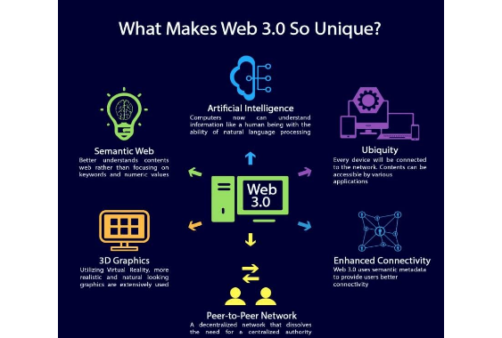
Semantic Web Architecture
From Strings to Things
In Web 2.0, search engines match keywords ("strings"). In Web 3.0, the semantic web understands underlying concepts and entity relations ("things").
RDF (Resource Description Framework): Represents data as Subject-Predicate-Object triples.
•
Ontologies (OWL): Defines precise domain logic and relationship rules.
•
•
Intelligent Agents: Autonomous software programs executing complex query reasoning across systems.

Slide 16
Key Characteristics of Web 3.0
Ubiquitous Intelligence
AI algorithms continuously process semantic metadata to personalize interactions, automate workflows, and predict search intent.
Decentralization
Data ownership and state management transition from centralized servers to peer-to-peer ledger protocols and decentralized clouds.
Ubiquity & 3D Web
Seamless access across IoT devices, edge nodes, AR/VR environments, and pervasive computing frameworks.

Slide 17
Convergence: Cloud & Web 3.0
Hybrid Infrastructure Backbones
Web 3.0 protocols (IPFS, Ethereum, Chainlink) require massive compute, low latency storage, and high availability provided by cloud hyperscalers.
Cloud providers offer managed blockchain RPC nodes, AI model hosting (LLMs), and decentralized storage gateway connectors.

Slide 18
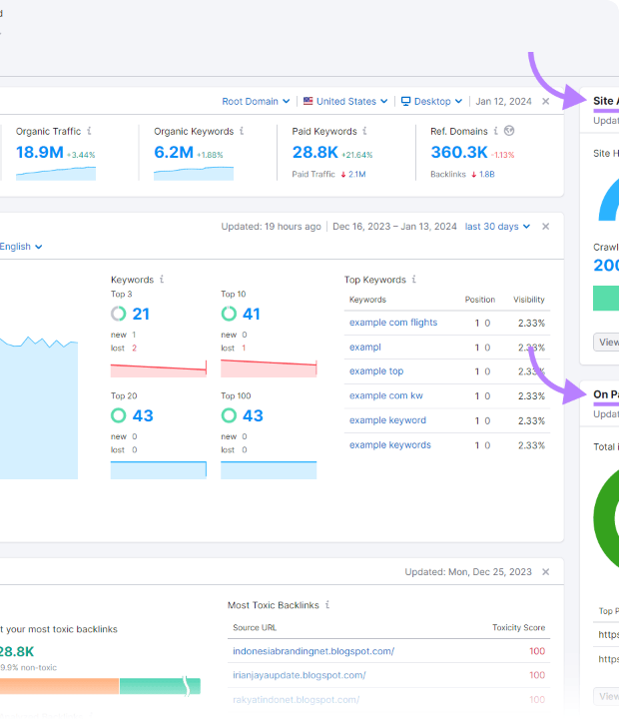
Case Study 1: Best Buy Commerce
Search Optimization via GoodRelations
Challenge: Search engine crawlers struggled to understand complex product specifications, store inventory, and dynamic pricing across thousands of SKUs.
Semantic Solution: Best Buy embedded Good Relations RDF a semantic markup into their product pages.
Outcome: Search engines instantly indexed product attributes, increasing organic traffic, click-through rates, and targeted e-commerce conversions.

Slide 19
Case Study 2: Connecting Info (Facebook)
Open Graph Protocol: Facebook introduced semantic Open Graph meta tags (og:title, og:type, og:image), transforming standalone webpages into semantic objects in a global social graph.
Graph Search & Entity Mapping: By connecting users, places, interests, and media as nodes and edges, natural queries like "Friends who live in Seattle and like hiking" became instantly solvable.
Cloud-Scale Analytics: Real-time processing of billions of social graph connections executed across distributed multicore compute clusters.

Slide 20

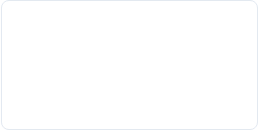

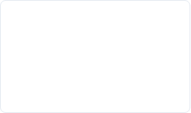
Evolutionary Roadmap
Web 3.0
Web 2.0
Semantic RDF graph, AI integration, decentralized cloud convergence.
Dynamic AJAX, social networks, user content, early Cloud SaaS.
Web 1.0
Multicore Cloud
Static HTML, Read-Only directories, single-core desktop servers.
Hypervisors, vCPU scaling, task & data parallelism, mega datacenters.

Slide 21
Questions & Discussion
Thank you for participating in today's Cloud Computing session.

